Slide 1
AWS Cloud for Atmospheric Scientists
Fei Yao
School of GeoSciences
The University of Edinburgh
https://www.geos.ed.ac.uk/homes/s1855106/

Slide 2
Contents
What is Cloud Computing?
What is AWS Cloud and Why?
Access & Use AWS Cloud with a Joint Account
Basic usage
Advanced topics
Summary & Prospects

Slide 3
Contents
What is Cloud Computing?
What is AWS Cloud and Why?
Access & Use AWS Cloud with a Joint Account
Basic usage
Advanced topics
Summary & Prospects

Slide 4
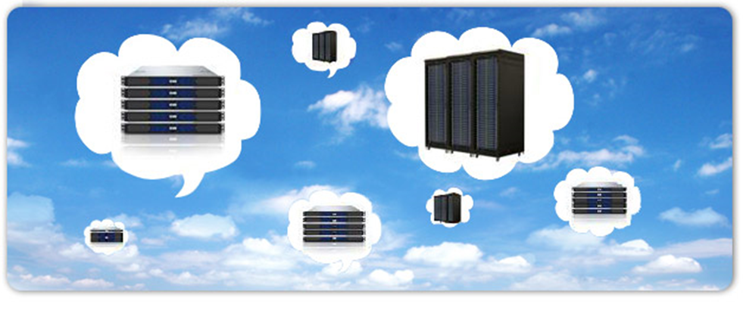
What is Cloud Computing?
Cloud Computing is on-demand delivery of IT resources and applications via the Internet with pay-as-you-go pricing.
Usually costs, but always cost-effective
Elastic and scalable (dynamically adjust hardware as needed)
Replication, replication, replication!
Globally available in seconds

Slide 5
Contents
What is Cloud Computing?
What is AWS Cloud and Why?
Access & Use AWS Cloud with a Joint Account
Basic usage
Advanced topics
Summary & Prospects

Slide 6







What is AWS Cloud and Why?
Cloud Computing with Amazon Web Services
Trade capital expense for variable expense
Increase speed and agility
Stop spending money on running and maintaining data centers
Benefit from massive economies of scale
Stop guessing capacity
Go global in minutes

Slide 7
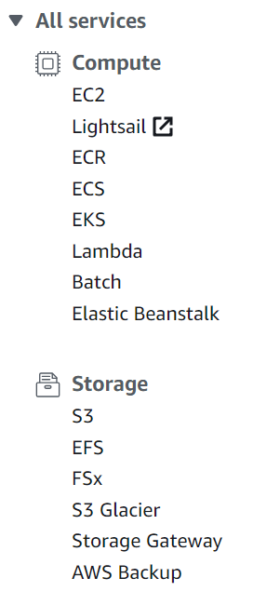
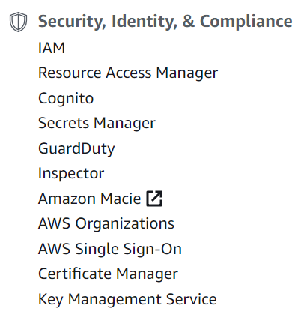
What is AWS Cloud and Why?
Identity and Access Management
Elastic Compute Cloud
Simple Storage Service

Slide 8
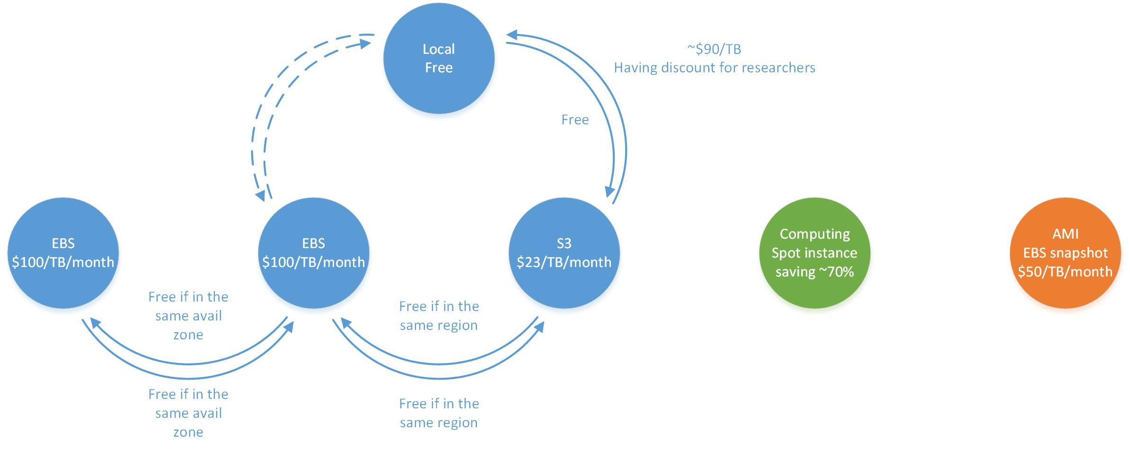
What is AWS Cloud and Why?
Cloud Computing with Amazon Web Services
Pricing management
Notes:
Pricing reference can be found here:
https://aws.amazon.com/ec2/pricing/
https://aws.amazon.com/s3/pricing/

Slide 9
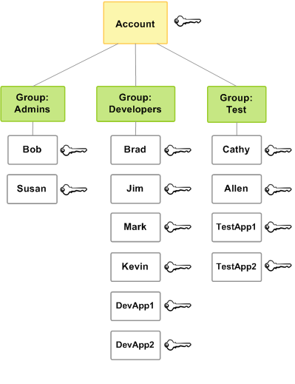
What is AWS Cloud and Why?
Group AWS Management via IAM
Root user has complete permissions
Admins have almost complete permissions except for billing and credit
Coming in the future, hopefully

Slide 10
Contents
What is Cloud Computing?
What is AWS Cloud and Why?
Access & Use AWS Cloud with a Joint Account
Basic usage
Advanced topics
Summary & Prospects

Slide 11
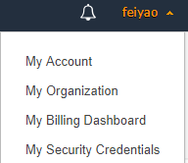
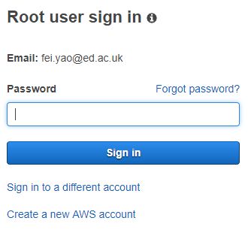
Access & Use AWS Cloud with a joint account – Basic Usage
Sign In to the Console as root user
Console login link
https://signin.aws.amazon.com/console
User name
Password
Notes:
Update screenshot.
Password changing is in My security Credentials -> AWS IAM credentials -> Password for console access -> Change password

Slide 12
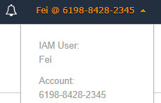
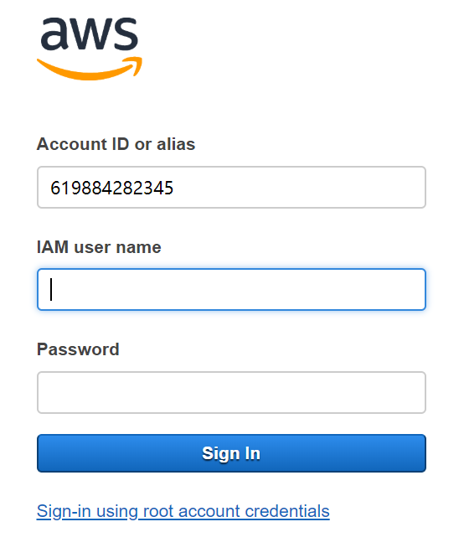
Access & Use AWS Cloud with a joint account – Basic Usage
Sign In to the Console as an IAM user
Console login link
https://619884282345.signin.aws.amazon.com/console
User name
Password
Notes:
Update screenshot.
Password changing is in My security Credentials -> AWS IAM credentials -> Password for console access -> Change password

Slide 13
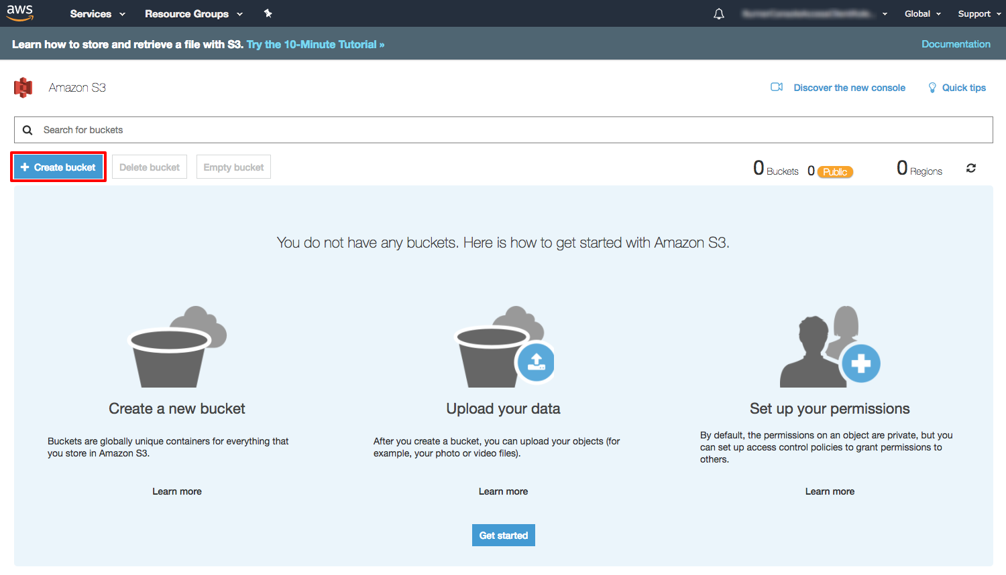
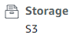
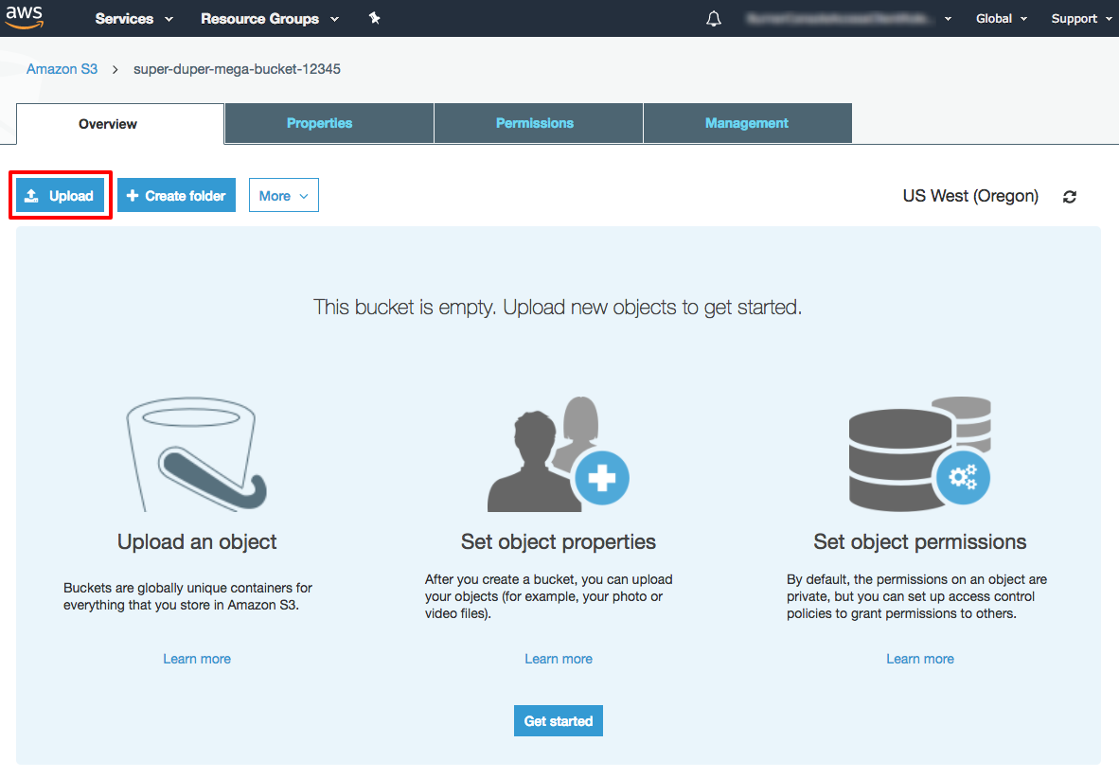
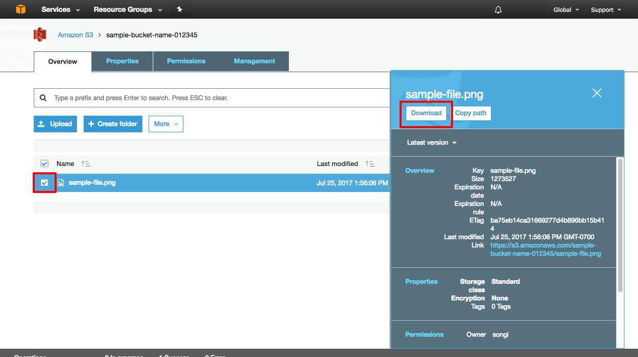
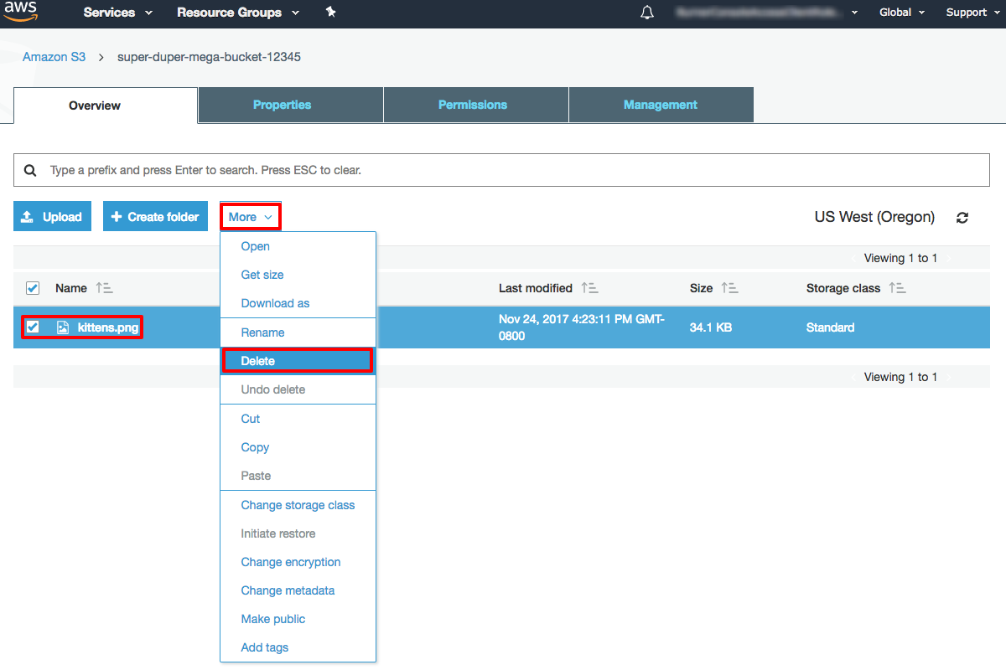
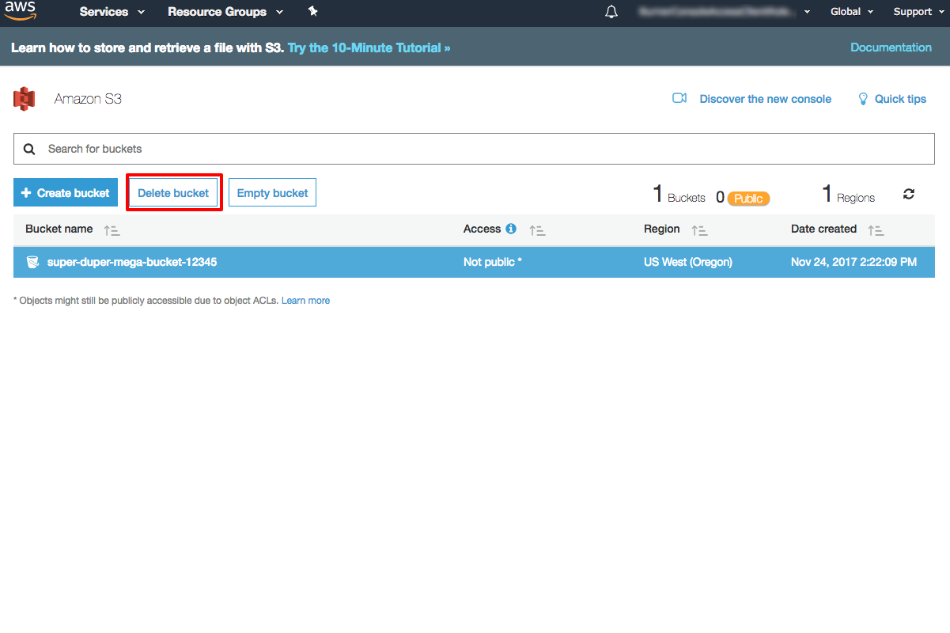
Access & Use AWS Cloud with a joint account – Basic Usage – S3
Manipulate S3 in Graphical Console
Create unique buckets, folders
Upload and download files (objects)
Remove files, folders, and buckets
Notes:
https://aws.amazon.com/getting-started/tutorials/backup-files-to-amazon-s3/.

Slide 14
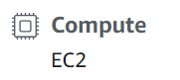
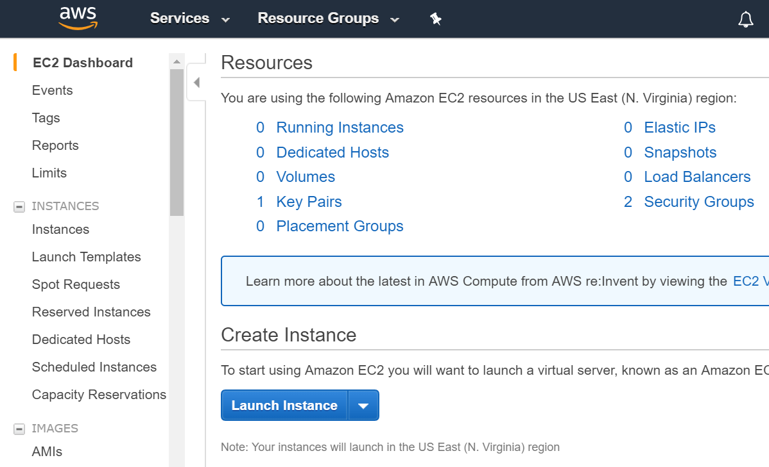
Access & Use AWS Cloud with a joint account – Basic Usage – EC2
Step 1. Switch to EC2 Dashboard
Click
Amazon Machine Image specifies the software side of an EC2 instance (computer). By replicating it, you avoid installing operating system, software, libraries, etc.
Notes:
Update screenshot if the number of Key Pairs, Security Groups are not the same.

Slide 15
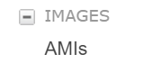
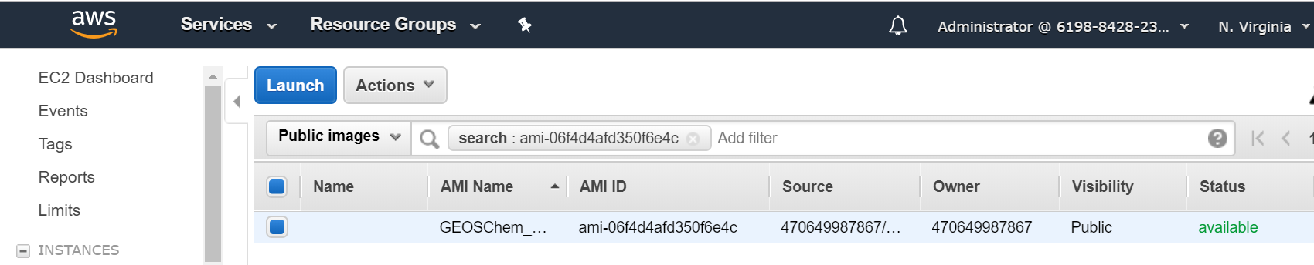
Access & Use AWS Cloud with a joint account – Basic Usage – EC2
Step 2. Search for a specific AMI such as GEOS-Chem
Search for ami-06f4d4afd350f6e4c from Public images in the US East (N. Virginia) region – that’s the system with both the classic and the High-Performance versions of GEOS-Chem installed.
Click
Notes:
Update screenshot.

Slide 16

Access & Use AWS Cloud with a joint account – Basic Usage – EC2
Step 3. Launch from that AMI and choose an Instance Type
Instance Type specifies hardware side of an EC2 instance, mostly about CPUs.
For longer-term, higher-resolution runs, consider bigger ones like c5.9xlarge and c5.18xlarge.
Click

Slide 17
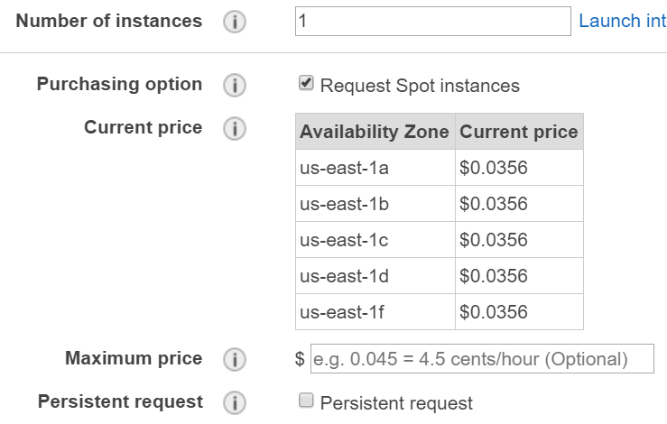
Access & Use AWS Cloud with a joint account – Basic Usage – EC2
Step 4. Configure Instance Details
You can launch several instances per time
Spot instances can always save ~70% money compared to
on-demand ones.
Choose this role to enable following awscli on EC2
Notes:
Full_S3_access_from_EC2: https://cloud-gc.readthedocs.io/en/latest/chapter03_advanced-tutorial/iam-role.html#create-a-new-iam-role

Slide 18
Access & Use AWS Cloud with a joint account – Basic Usage – EC2
Step 5. Add Storage
The volume attached to EC2 instance is called Elastic Block Storage (EBS) and can be used by EC2 instance directly. S3 is independent of any EC2 instances. AWS provides a series of commands to help transfer data between S3 and EC2 very efficiently (>100MiB/s).
You need to use up/down arrow key to adjust volume size attached to the EC2 instance.

Slide 19
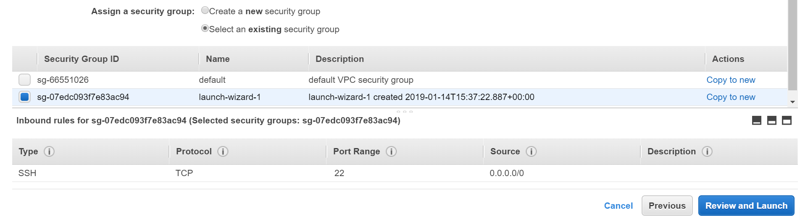
Access & Use AWS Cloud with a joint account – Basic Usage – EC2
Step 6. Configure Security Group
“Security group” controls what IPs are allowed to access your server. Use an pre-defined one allowing all IPs to access is generally fine because we also need to have the EC2 Key Pair in order to access to a specific server.
Notes:
Update screenshot because launch-wizard-1 created time differs.

Slide 20
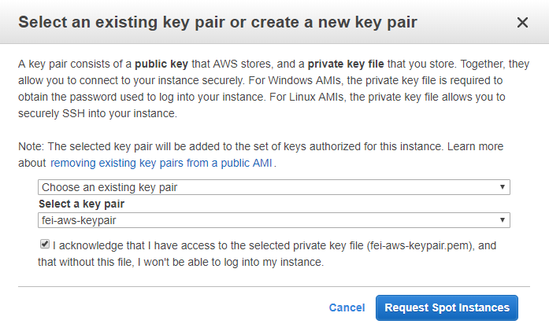
Access & Use AWS Cloud with a joint account – Basic Usage – EC2
Step 7. Review & Launch
EC2 Key Pair is equivalent to the password you enter to ssh to your local server, but much more secure.
Notes:
Update screenshot.

Slide 21
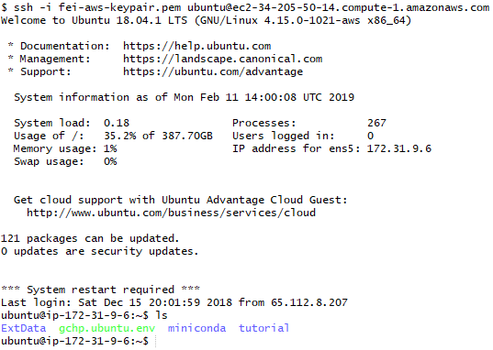
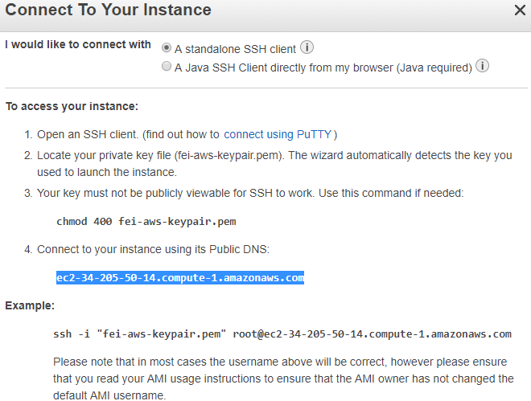
Access & Use AWS Cloud with a joint account – Basic Usage – EC2
Step 8. Connect
Recommend
Git Bash
root -> ubuntu
Something already here
Notes:
Update screenshot.

Slide 22
Access & Use AWS Cloud with a joint account – Basic Usage
Manipulate S3 with AWSCLI in EC2
Create bucket
See bucket
Upload/download files/directories
Remove files/directories
aws s3 mb s3://bucket-name
aws s3 ls s3://bucket-name
aws s3 cp [--recursive] source target
aws s3 rm [--recursive] target
Source & target can be any combination of S3, EC2, Local and S3.
These commands together with aws ec2 … are also applicable in local machines provided you properly install and configure awscli.

Slide 23



Amazon S3
OneDrive, Dropbox, etc.
Hardware:
Changeable anytime
Hardware:
Usually unchangeable
Software:
Replicate AMI
Software:
Install manually
EC2
instance
holmes
burn
Amazon EBS
/geos/u73
/geos/d21
…

Slide 24
Access & Use AWS Cloud with a joint account – Basic Usage – GEOS-Chem
Get source code and checkout model versions
Make a separate folder
Enter that folder
Download GEOS-Chem source code & Unit tester
Do version control if needed
mkdir ~/GC
cd ~/GC
git clone https://github.com/geoschem/geos-chem Code.GC
git clone https://github.com/geoschem/geos-chem-unittest.git UT
cd Code.GC (UT)
git log --tags --simplify-by-decoration --pretty="format:%ci %d“
git checkout 12.1.0; git branch
git checkout master

Slide 25
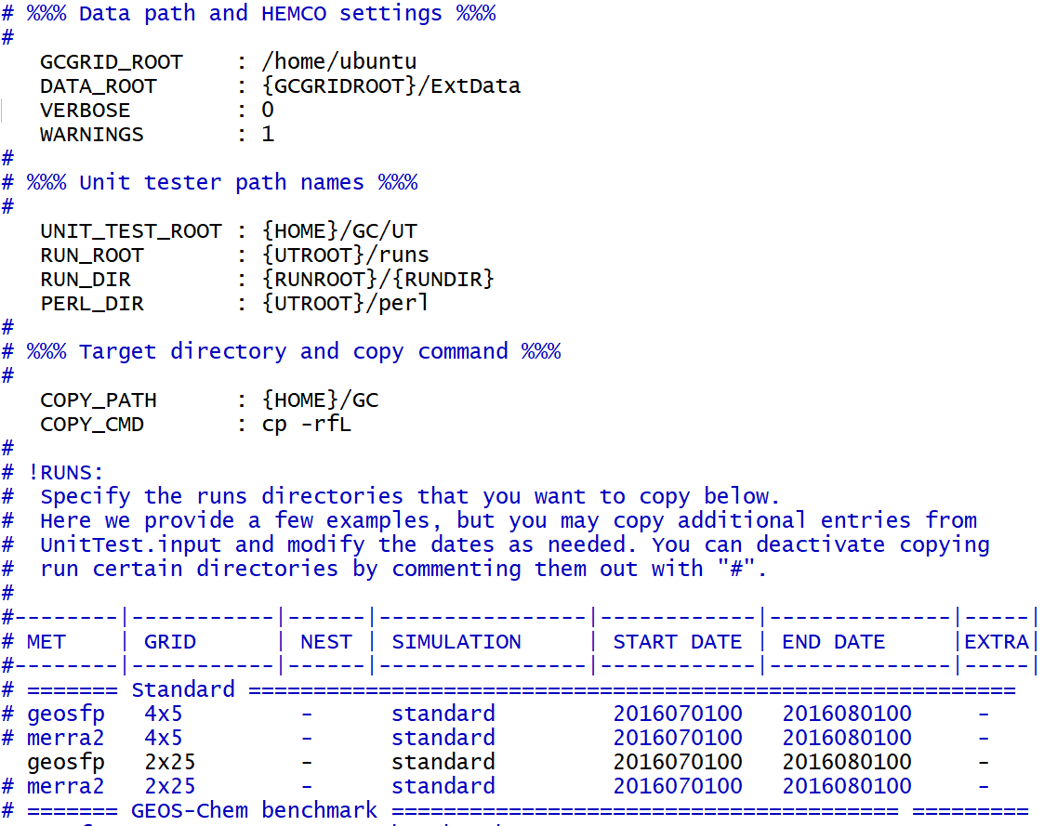
Access & Use AWS Cloud with a joint account – Basic Usage – GEOS-Chem
Configure unit tester and generate run directory
Change GCGRID_ROOT
Change DATA_ROOT
Change UT_TEST_ROOT
Change COPY_PATH
Un-comment the desired run directory
./gcCopyRunDirs
Notes:
In UT/perl/CopyRunDirs.input. It is 2x2.5!
CopyRunDirs.input displays version 12.1.0.

Slide 26
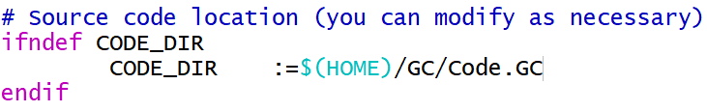
Access & Use AWS Cloud with a joint account – Basic Usage – GEOS-Chem
Configure Makefile and Compile the source code
Change source code path
Compile
Remove all pre-compiled ones
-j4 denotes 4 jobs simultaneously
mpbuild denotes using multiple processors
NC_DIAG denotes exporting netCDF diagnostics
BPCH_DIAG denotes exporting BPCH diagnostics
TIMERS?
make realclean
make -j4 mpbuild NC_DIAG=y BPCH_DIAG=n TIMERS=1
Notes:
In GC/geosfp_4x5_standard
Makefile displays version 12.1.1, contradicting with that in CopyRunDirs.input

Slide 27
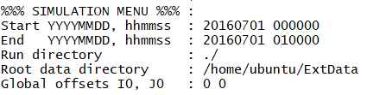
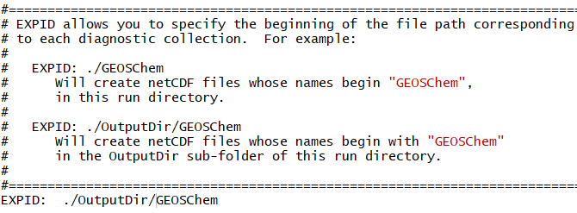
Access & Use AWS Cloud with a joint account – Basic Usage – GEOS-Chem
Configure input.geos and HISTORY.rc
Change simulating period
Create a directory named OutputDir
under the run directory
Notes:
GEOS-Chem 12.1.1 can now output netCDF diagnotics, indicating necessity of specifying HISTORY.rc.
Beware of simulation period and frequency settings (segmentation error).
GEOSChem needs to be created before model running if write netCDF Diagnostics to it (code error).
You can also configure HEMCO_Config.rc during this step.

Slide 28
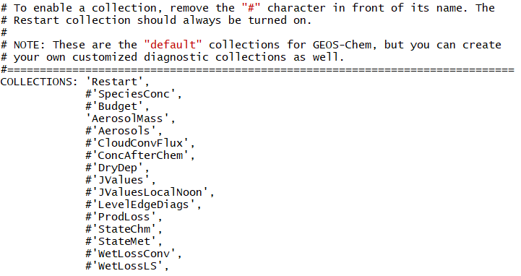
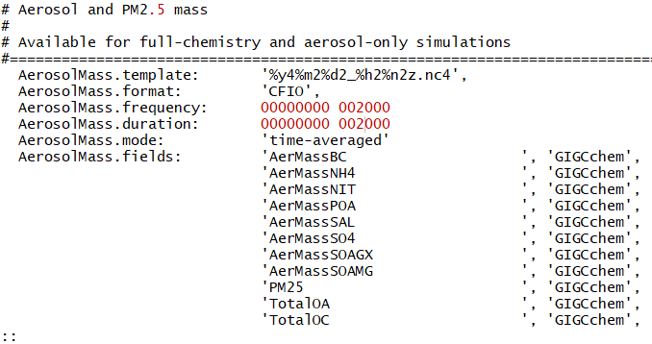
Access & Use AWS Cloud with a joint account – Basic Usage – GEOS-Chem
Configure input.geos and HISTORY.rc
Remove # to collect
Specify collection
Frequency
Duration
Mode

Slide 29
Access & Use AWS Cloud with a joint account – Basic Usage – GEOS-Chem
Pull shared data from S3 to EC2
s3://gcgrid is where GEOS-Chem shared data reside.
for month in {07 08}
do
aws s3 cp --request-payer=requester --recursive \
s3://gcgrid/GEOS_2x2.5/GEOS_FP/2016/$month \
~/ExtData/GEOS_2x2.5/GEOS_FP/2016/$month
done

Slide 30
Access & Use AWS Cloud with a joint account – Basic Usage – GEOS-Chem
Obtain additional files
GEOSFP 2x2.5 CN metfield
aws s3 cp --request-payer=requester --recursive s3://gcgrid/GEOS_2x2.5/GEOS_FP/2011/01/ ~/ExtData/GEOS_2x2.5/GEOS_FP/2011/01/
2x2.5 restart file
aws s3 cp --request-payer=requester s3://gcgrid/GEOSCHEM_RESTARTS/v2018-11/initial_GEOSChem_rst.2x25_standard.nc ~/ExtData/GEOSCHEM_RESTARTS/v2018-11/
fix the softlink in run directory
ln -s ~/ExtData/GEOSCHEM_RESTARTS/v2018-11/initial_GEOSChem_rst.2x25_standard.nc ~/GC/geosfp_2x25_standard/GEOSChem.Restart.20160701_0000z.nc4
Notes:
Why red 20160701_0000z.nc4?
Answer: ncdump –ct initial_GEOSChem_rst.2x25_standard | less (using space key, g, G, and q to control) gives the real information of initial restart file (time:units = "hours since 2013-07-01 00:00:00 GMT“, time = 0). We can also rename to 20160801_0000z.nc4, the model will run smoothly but certainly unacceptable.
It seems that GEOS-Chem 12.1.1 no longer specifies restart files in input.geos?
In terms of Makefile, the definition of GC_RST seems a little bit weird? $(ENDDATE)_$(ENDTIME)
Give the first and second running time of one month simulation with one month spin-up. (With restart file at 2016-07-01-0000 and simulating start data at 2016-08-01-0000 and all met data of month 07 and 08? Confirm with Feng Liang)

Slide 31
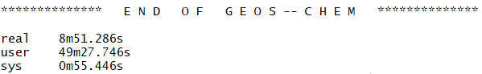
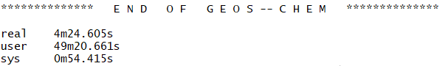
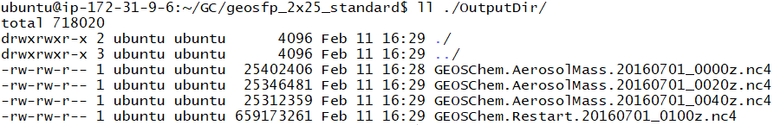
Access & Use AWS Cloud with a joint account – Basic Usage – GEOS-Chem
Run GEOS-Chem
Subject to:
Instance type
time steps
“Warm-up”
Denotes time-averaged value between 20160701-0000z to 20160701-0020z
run GEOS-Chem (To monitor running time, type time ./geos.mp)
./geos.mp

Slide 32
Access & Use AWS Cloud with a joint account – Basic Usage – GEOS-Chem
Analyze model outputs using Jupyter
Re-connect using port-forwarding
ssh -i "your-key-name.pem" ubuntu@xxx.amazonaws.com -L 8999:localhost:8999
Activate geo python environment
source activate geo
Start a jupyter
jupyter notebook --NotebookApp.token='' --no-browser --port=8999 --notebook-dir ~/
Open the url and write analyzing codes
http://localhost:8999/
Deactivate geo environment
source deactivate

Slide 33
Access & Use AWS Cloud with a joint account – Basic Usage – GEOS-Chem
Save files to S3, terminate server, and start over whenever needed
Save files (most time run directories) to S3
aws s3 cp --recursive ~/GC s3://fei-geoschem-run-directory/GC
Terminate server (to do this in the graphical console is convenient enough)
Start an EC2 Instance again (steps have been described before)
Retrieve run directories from S3 back to EC2
aws s3 cp --recursive s3://fei-geoschem-run-directory/GC ~/GC
Restore execution permission for geos.mp
chmod u+x ~/GC/geosfp_2x25_standard/geos.mp
Obtain shared data and GEOSFP 2x2.5 CN metfield (refer to p.28, 29)
Notes:
No need to retrieve restart files again as aws cp copies real data!

Slide 34
Access & Use AWS Cloud with a joint account – Basic Usage
Satellite remotely sensed data processing
Launch an EC2 instance
Upload satellite data to S3 (bear in mind that some satellite data are already in S3)
Pull satellite data from S3 to EC2
Write Python or similar codes to process satellite data
Export processed data to S3 and shut down EC2

Slide 35
Contents
What is Cloud Computing?
What is AWS Cloud and Why?
Access & Use AWS Cloud with a Joint Account
Basic usage
Advanced topics
Summary & Prospects

Slide 36
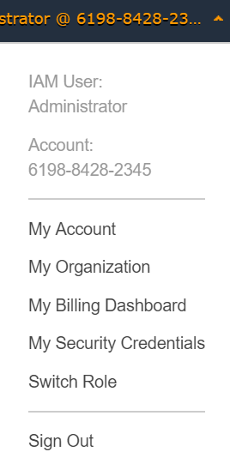
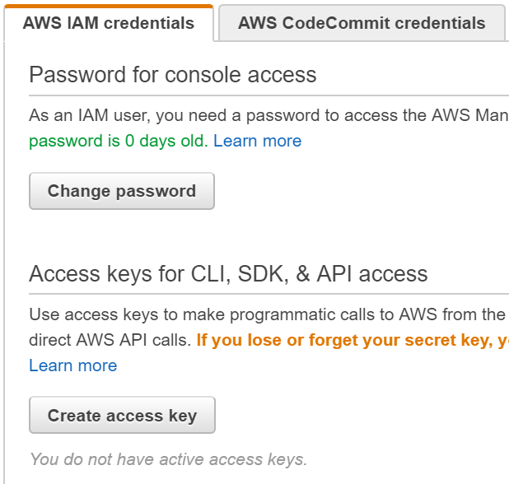
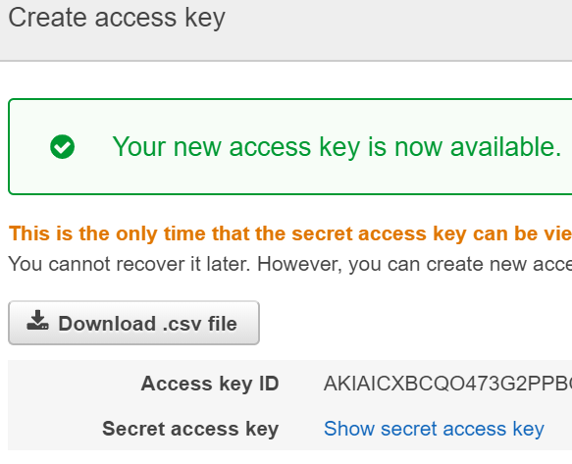
Access & Use AWS Cloud with a joint account – Advanced Topics
Simplify login process via scripts
Create Access Key under My security credentials dashboard
Notes:
Update screenshot.

Slide 37
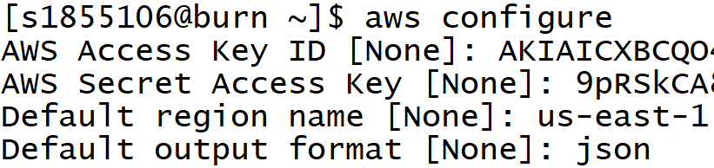
Access & Use AWS Cloud with a joint account – Advanced Topics
Simplify login process via scripts
Install AWSCLI on your own computer (i.e. pip install awscli)
Run aws configure
Configure files are stored in ~/.aws directory
It’s in the accessKeys file you downloaded
us-east-1 is an alias to the “US East (N. Virginia)” region
Specify configure output format as json

Slide 38
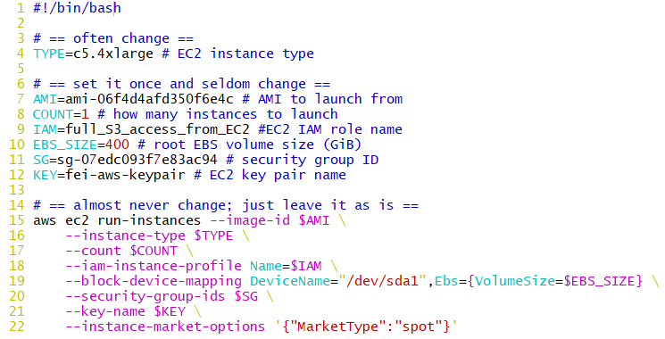
Access & Use AWS Cloud with a joint account – Advanced Topics
Simplify login process via scripts
Write a script and store it in a directory contained in $PATH
Run the script from terminal
Export the AWSCLI path
under Windows
If require spot instance

Slide 39
Access & Use AWS Cloud with a joint account – Advanced Topics
Keep program running after logging out using tmux
Create a new session
Split a panel
Switch between panels
Detach from a session
List all sessions
Attach to a session
tmux new –s session_name
Ctrl-b %/”
Ctrl-b ←/→/↑/↓
Ctrl-b d
tmux list
tmux attach –t session_name
Notes:
https://www.hamvocke.com/blog/a-quick-and-easy-guide-to-tmux/
Create a new window: Ctrl-b c
Switch between windows: Ctrl-b p/n/number
Kill a panel: Ctrl-b q & number; Ctrl-d
Kill a session: Ctrl-d; tmux kill-session –t session_name

Slide 40
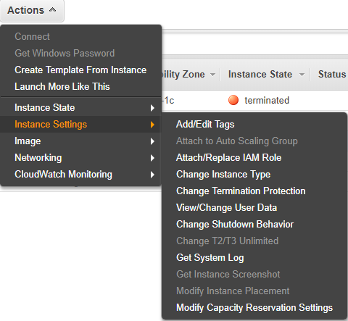
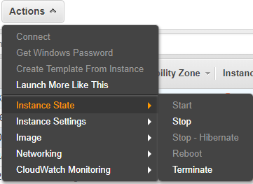
Access & Use AWS Cloud with a joint account – Advanced Topics
What if I want to change Instance Type of a launched EC2 instance?
On-demand instances support this kind of demand.
Stop the instance -> Change its instance type
-> start it again
Notes:
Omit this slide simply because I have reached my limit?

Slide 41
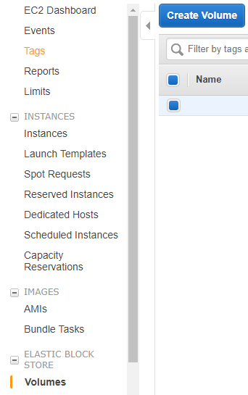
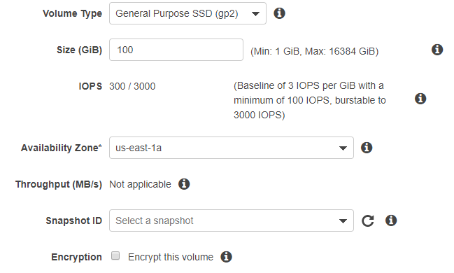
Access & Use AWS Cloud with a joint account – Advanced Topics
What if I need more volume size to a launched EC2 instance?
Create a volume

Slide 42
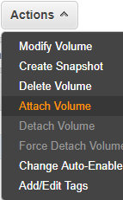
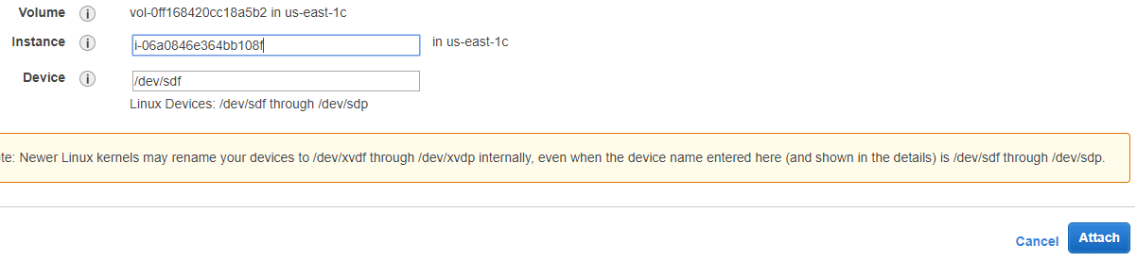
Access & Use AWS Cloud with a joint account – Advanced Topics
What if I need more volume size to a launched EC2 instance?
Attach that volume to an EC2 instance

Slide 43
Access & Use AWS Cloud with a joint account – Advanced Topics
What if I need more volume size to a launched EC2 instance?
Make that volume usable
Show that volume to be mounted
lsblk
Create a file system for that volume
sudo mkfs -t ext4 /dev/nvme1n1
Mount that volume to a directory
mkdir new_disk
sudo mount /dev/nvme1n1 new_disk
Show the mounted volume
df –h
Change permission
sudo chown ubuntu new_disk
Touch a new file
touch ~/new_disk/new_text

Slide 44
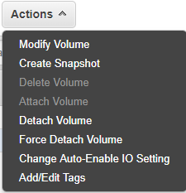
Access & Use AWS Cloud with a joint account – Advanced Topics
What if I need more volume size to a launched EC2 instance?
Share files between EC2 instances via EBS
Umount the mounted volume
sudo umount /dev/nvme1n1
Rmove new_disk (Optional)
rmdir new_disk
Detach that volume
Attach to another instance
Mount that volume to a directory
mkdir new_disk
sudo mount /dev/nvme1n1 new_disk
Show contents in new_disk
ls new_disk/

Slide 45
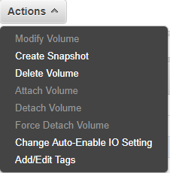
Access & Use AWS Cloud with a joint account – Advanced Topics
What if I need more volume size to a launched EC2 instance?
Sweep the battlefield
Save files to S3 if applicable
Umount the mounted volume
sudo umount /dev/nvme1n1
Rmove new_disk (Optional)
rmdir new_disk
Detach that volume
Delete that volume
Notes:
NB. EBS volume created must be manually deleted!

Slide 46
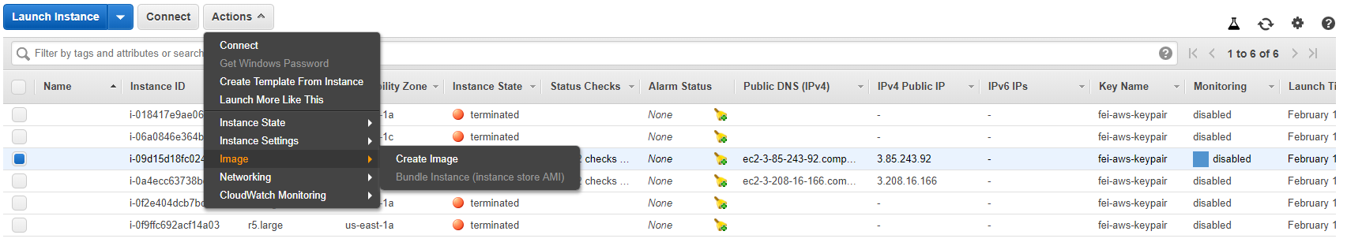
Access & Use AWS Cloud with a joint account – Advanced Topics
What if I want to customize my own EC2 instance and save it in order to facilitate later use?
Launch an instance from a clean AMI
Install compliers, libraries, and etc. by apt or yum dependent on which system you launch
Save that instance as your AMI
Notes:
https://cloud-gc.readthedocs.io/en/latest/chapter04_developer-guide/install-basic.html

Slide 47
Contents
What is Cloud Computing?
What is AWS Cloud and Why?
Access & Use AWS Cloud with a Joint Account
Basic usage
Advanced topics
Summary & Prospects

Slide 48
Summary & Prospects
(Zhuang et al., 2019,
submitted to BAMS)

Slide 49
Summary & Prospects
High Performance GEOS-Chem
Already on AWS deserving exploration.
More flexible permission controls within group
Will surely come in the near future with your effort.
Prepayment
e.g. Reserved Instance

Slide 50
Materials mainly from:
GEOS-Chem on AWS cloud tutorial
https://cloud-gc.readthedocs.io/en/latest/index.html
AWS Document
https://docs.aws.amazon.com/index.html#lang/en_us

Slide 51
Thanks! Your Response is appreciated!

